Slide 1
Research Computing Update
January 2021

Slide 2
HPC Resources
New HPC Procurement via ANKABUT
Hardware has been delivered and processed in time!
Kick-off meeting taken with initial project plan and milestones
Hardware is currently being installed
Configuration expected to start mid-February
SAN HPC Cluster
SAN HPC cluster to be decommissioned by end of January 2021
Have received quote for the decommissioning of hardware.
Moving data is still in process.

Slide 3
Resource Utilization

Slide 4
KU Cluster core distribution

Slide 5
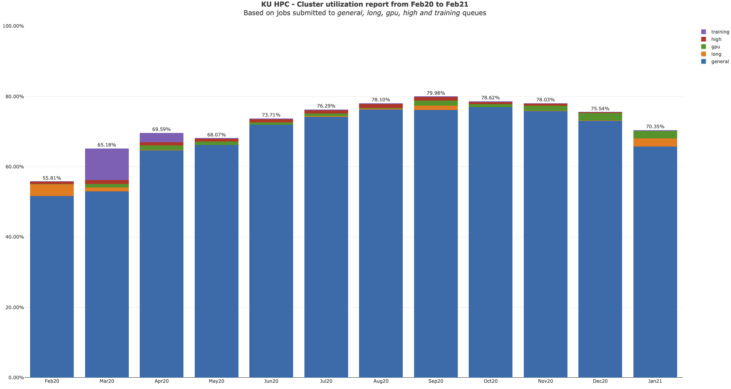

Slide 6
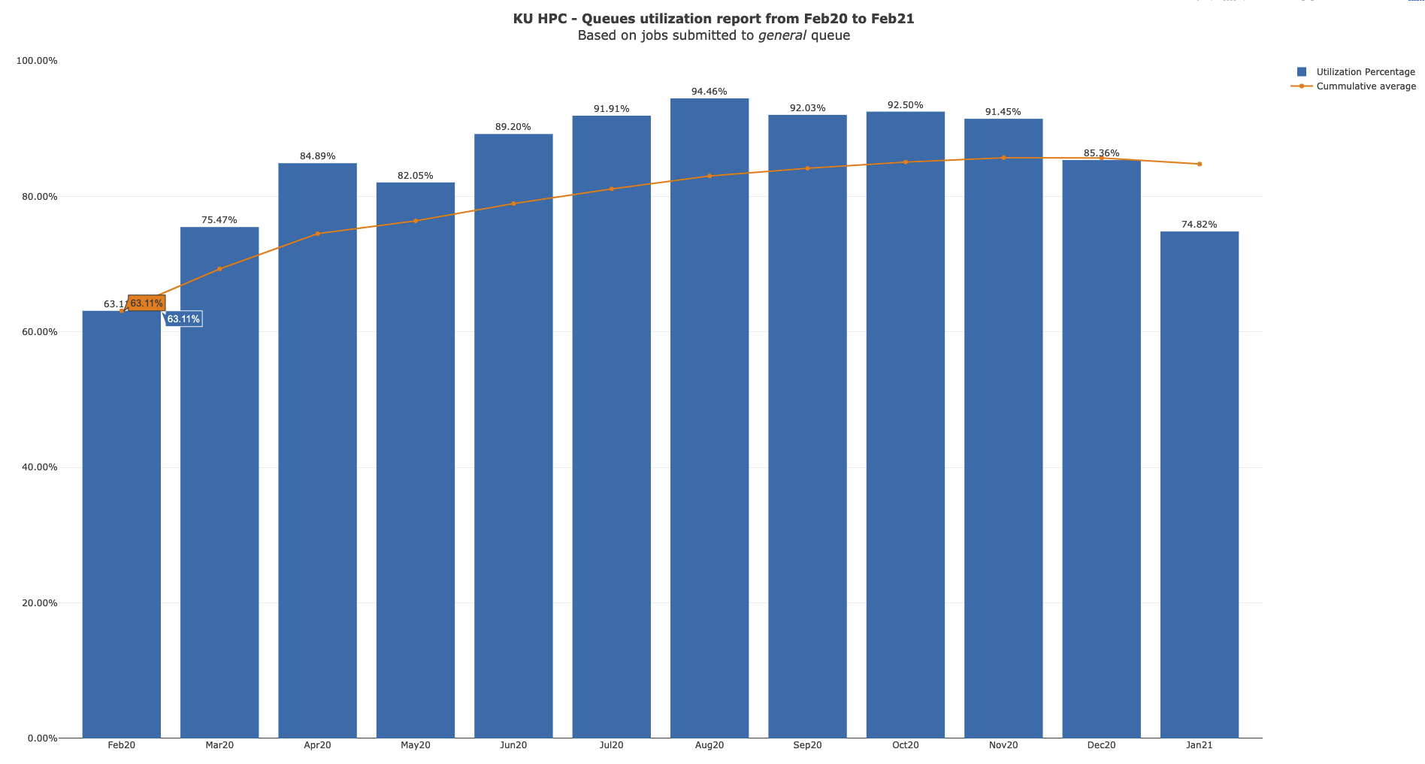

Slide 7
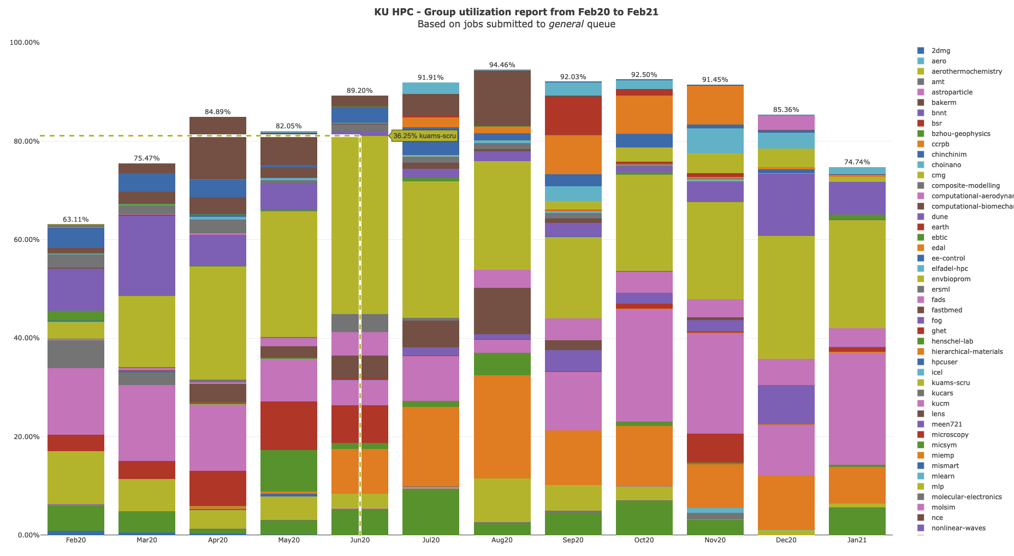

Slide 8
KU HPC Group Utilization for January 2021.
Note that do not yet keep track of applications used automatically. This is a work in progress, and will be added to future reports.

Slide 9
PI Cluster core distribution

Slide 10
